Slide 1

Meta Genomic Data Analytics
22BIO201 Intelligence of Biological Systems - 1
Team 7 :​
G Prajwal Priyadarshan - 214​
Kabilan K - 224​
Kishore B - 227
​ Rahul L S - 248​
​

Slide 2
Introduction
Meta Genomics
Metagenomics is the study of all the genetic material (DNA) collected directly from environmental samples — like soil, water, or the human body — to identify the different microbes present and understand what they can do, without the need to grow them in a lab.

Slide 3
->To analyze publicly available metagenomic datasets to identify the types of microbes present in a sample and understand their functional roles, using computational tools and AI techniques. ->Use publicly available metagenomic data (no lab work needed). Cleans and processes the DNA data using bioinformatics tools. ->Find out: Which microbes are present (species identification). What they can do (functional roles). ->Can be applied in healthcare, environment, and agriculture.
Meta Genomic Data Analysis

Slide 4
Problem Statement
Metagenomic datasets contain vast amounts of raw DNA sequences from mixed microbial communities, but this data is often unstructured, noisy, and difficult to interpret. There is a need for efficient computational methods to clean, classify, and analyze these datasets to identify the diversity of microbes present and understand their functional roles. Without proper data analytics, valuable biological insights remain hidden, limiting applications in healthcare, environmental monitoring, and agriculture.
5
2

Slide 5
Objective
Processing raw metagenomic sequencing reads obtained from public repositories (e.g., Tara Oceans, MG-RAST, NCBI SRA).
Performing taxonomic profiling to classify reads into taxonomic groups (domain, phylum, class, order, family, genus, species).
Comparing performance of multiple classification tools in terms of accuracy, computational efficiency, and resolution.
Deriving biological insights about microbial diversity, relative abundance, and possible ecological roles in the sampled environments.

Slide 6
Base Paper
The paper is a tutorial/review explaining how metagenomic analysis works, especially for crop soils (rhizosphere of rice, wheat, legumes, chickpea, sorghum).
What Is KMAP & Paper’s Role?
KMAP is a web-based, open-access software platform for exploring, analyzing, and comparing massive metagenomic datasets—especially shotgun sequencing datasets.
This paper’s main goal: to offer researchers (even with limited compute resources) an easy way to access millions of publicly available metagenomes and their annotated genes—so you don’t always need to generate raw data.

Slide 7
Methodology
Metagenomics is the study of genetic material recovered directly from environmental samples without the need to culture individual microorganisms. It allows researchers to analyze the collective genomes of entire microbial communities, providing insights into:
Community composition (Who are the microbes?)
Functional potential (What can they do?)
Ecological interactions (How do they interact?)
Metabolic pathways and biochemical processes
The term was coined by Jo Handelsman in 1998, who defined it as "the cloning and functional analysis of collective genomes of soil microflora".

Slide 8
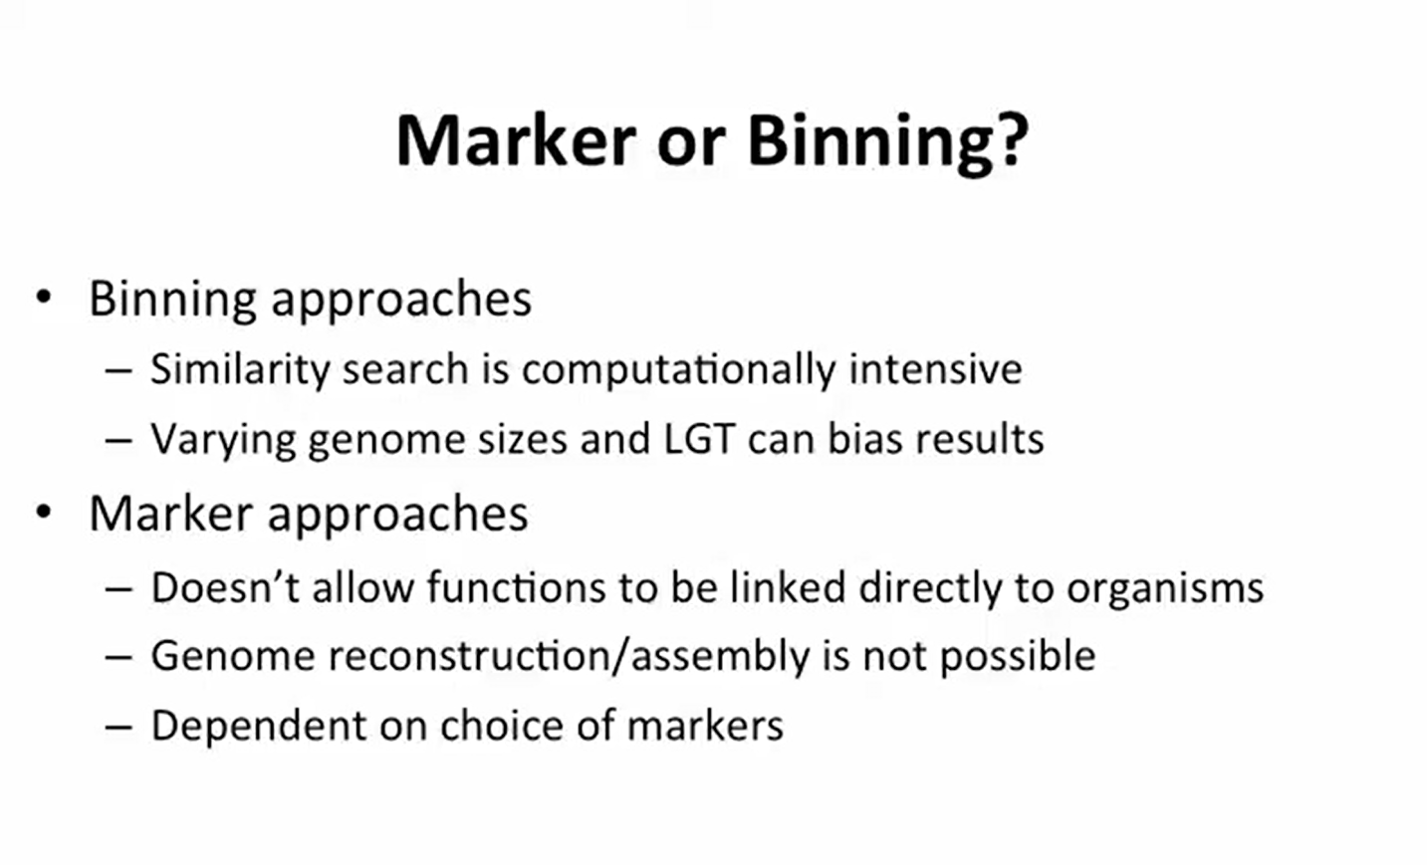

Slide 9
Methodology
MEGAN
MG-RAST
Kraken.

Slide 10
Methodology
Sample Collection and Processing
DNA Extraction and Isolation
Library Preparation and Sequencing
Data Analysis Pipeline
AI & ML Applications :
Taxonomic Classification
Binning and Assembly
Functional Annotation
Novel Gene Discovery

Slide 11
Expected outcome
A complete taxonomic profile of microbial communities present in the analyzed metagenomic dataset, showing relative abundance from domain to species level.
Identification of dominant and rare taxa, helping to understand community structure and ecological relationships in the sampled environment.
Performance comparison report between classification tools (e.g., Kraken2, MetaPhlAn3, Kaiju) highlighting differences in speed, memory usage, and taxonomic resolution.
Visualization outputs such as Krona charts, stacked bar plots, and heatmaps to intuitively represent microbial diversity.
Biological insights into potential functional roles of identified organisms and their relevance to the environment studied (e.g., ocean microbiome patterns, pathogen detection, biogeochemical cycles).

Slide 12
Conclusion
Enables identification of microbial diversity and functional roles directly from environmental samples.
Eliminates the need for culturing microbes in a lab.
Uses computational and AI-driven bioinformatics tools for efficient analysis.
Cleans, classifies, and interprets large volumes of raw sequencing data.
Unlocks valuable insights for healthcare, environmental monitoring, and agriculture.
Accelerates research and supports data-driven decision-making.

Slide 13
Thank You !

